Slide 1
Name: Ruchi Barai
Topic:
Meta Platform Update and
Performance

Slide 2

Introduction to SQL

Slide 3

SQL / Database
SQL (Structured Query Language) is a language used to communicate with databases. It helps users create, retrieve, update, and delete data stored in database tables.
Database is an organized collection of data stored electronically. It helps store, manage, and access information efficiently whenever needed.

Slide 4
Purpose
The purpose of this project is to create a database system that stores Meta platform updates and tracks employee performance. It helps manage data efficiently, monitor employee work, and generate useful reports.
Objectives
Store Meta update information.
Maintain employee details.
Track tasks completed by employees.
Measure employee performance.
Generate reports and insights.
Use Ensure data accuracy and consistency

Slide 5
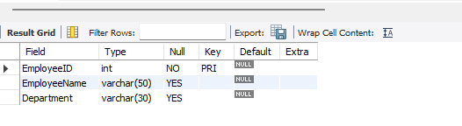
Q.1.Creating Table Employees, Meta Update and Performance
create database MetaPlatform;
use MetaPlatform;
CREATE TABLE Employees(EmployeeID INT PRIMARY KEY, EmployeeName VARCHAR(50),Department VARCHAR(30));

Slide 6
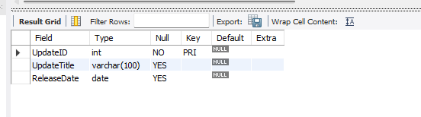
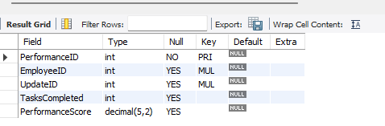
CREATE TABLE Meta_Updates(UpdateID INT PRIMARY KEY, Update Title VARCHAR(100), ReleaseDate DATE);
CREATE TABLE Performance (PerformanceID INT PRIMARY KEY, EmployeeID INT, UpdateID INT, TasksCompleted INT,PerformanceScore DECIMAL(5,2),FOREIGN KEY(EmployeeID) REFERENCES Employees(EmployeeID), FOREIGN KEY(UpdateID) REFERENCES Meta_Updates(UpdateID));

Slide 7
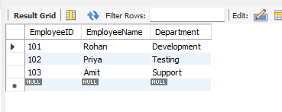
Q.2. Inserting Values in Employees, Meta_Updates,Performance
INSERT INTO Employees VALUES (101,'Rohan','Development’),
(102,'Priya','Testing'),(103,'Amit','Support’);
select * from Employees;

Slide 8
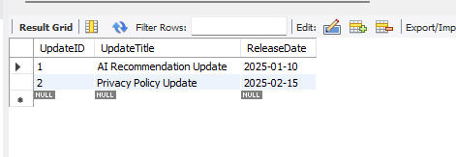
INSERT INTO Meta_UpdatesVALUES (1,'AI Recommendation Update','2025-01-10’),
(2,'Privacy Policy Update','2025-02-15’);
select * from Meta_Updates;

Slide 9
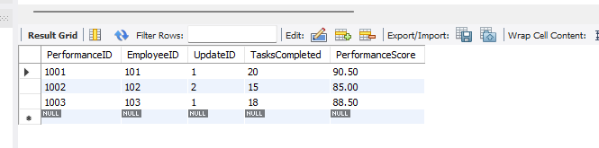
INSERT INTO Performance VALUES (1001,101,1,20,90.5),
(1002,102,2,15,85.0),(1003,103,1,18,88.5);
select * from Performance;

Slide 10


Q.3.Total Number Of Employees
SELECT COUNT(*) AS TotalEmployeesFROM Employees;
Q.4.Total Number Of Meta Updates
SELECT COUNT(*) AS TotalUpdatesFROM Meta_Updates;

Slide 11
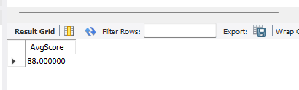

Q.5.Average Performance Score
SELECT AVG(PerformanceScore) AS AvgScoreFROM Performance;
Q.6.Highest Performance Score
SELECT MAX(PerformanceScore) AS HighestScoreFROM Performance;

Slide 12
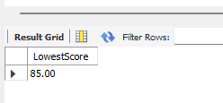
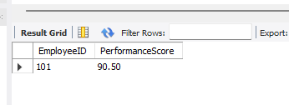
Q.7.Lowest Performance Score
SELECT MIN(PerformanceScore) AS LowestScore FROM Performance;
Q.8.Top Performing Employee
SELECT EmployeeID, PerformanceScore FROM Performance ORDER BY PerformanceScore DESC LIMIT 1;

Slide 13
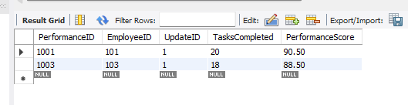
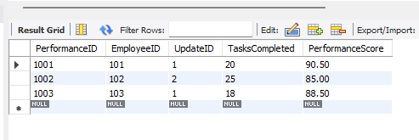
Q.9.Employees with Score Above 85
SELECT *FROM Performance WHERE PerformanceScore > 85;
Q.10.Updating Tasks Completion.
UPDATE Performance SET TasksCompleted = 25WHERE EmployeeID = 102;

Slide 14
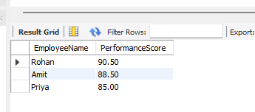
Q.11.Ranking employees based on Performance
SELECT e.EmployeeName, p.PerformanceScoreFROM Employees e JOIN Performance p ON e.EmployeeID = p.EmployeeID ORDER BY p.PerformanceScore DESC;

Slide 15
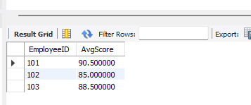
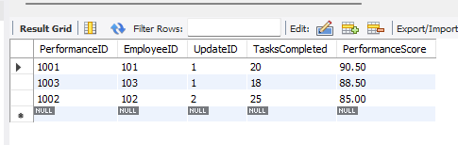
Q.12.Calculates the average performance score of each employee.
SELECT EmployeeID, AVG(PerformanceScore) AS AvgScore FROM Performance GROUP BY EmployeeID;
Q.13.Shows employees ranked from highest to lowest performance score
SELECT *FROM Performance ORDER BY PerformanceScore DESC;

Slide 16
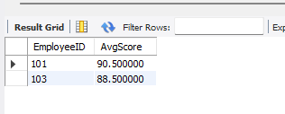
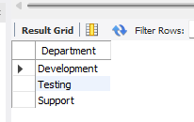
Q.14.Shows employees whose average score is above 85.
SELECT EmployeeID, AVG(PerformanceScore) AS AvgScore FROM Performance GROUP BY EmployeeID HAVING AVG(PerformanceScore) > 85;
Q.15.Displays unique departments without duplicates.
SELECT DISTINCT Department FROM Employees;

Slide 17
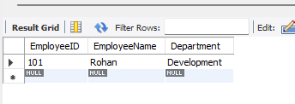
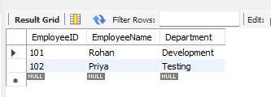
Q.16.Finds employees whose names start with “R”.
SELECT *FROM Employees WHERE EmployeeName LIKE 'R%’;
Q.17 Display Employees from either Development or Testing departments.
SELECT *FROM Employees WHERE Department = 'Development’ OR Department = 'Testing’;

Slide 18
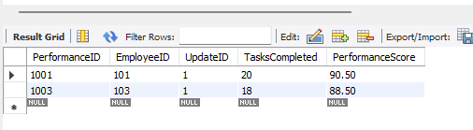
Q.18.Finds employees with high task completion and high performance.
SELECT *FROM Performance WHERE TasksCompleted > 15 AND PerformanceScore > 85;

Slide 19
Thankyou

